Slide 1
PSY102: Introduction to Cognitive Psychology
Day 8 (05/24/19): Review

Slide 2
Today’s Goals + Agenda
LO1: Continue to build a supportive classroom culture & discuss science communication.
Peer feedback of opening SciComm paragraphs in groups
Discuss choosing Wikipedia scientists for assignment
LO2: Describe the basic history of cognitive psychology & cognitive psychology perspectives on cognitive neuroscience
Review material from discussing Day 2 methodology, plus some basic principles on cog neuro (i.e., chpts 1-2 reading)
LO3: Review material that we have covered so far
Class feedback: wanted to slow down a bit & review Perception, some Attention concepts

Slide 3
What do you want to review?
“All of Perception, exogenous and endogenous cueing, and dichotic listening task”
“End of perception and beginning of attention”
“top-down vs. bottom-up processing, endogenous/exogenous cueing, Bayesian priors/likelihood”
“Top down vs bottom up, perception in general”
“Late perception early attention”
“Selective attention”
“top-down vs. bottom-up processing, endogenous/exogenous cueing”

Slide 4
What do you want to review?
Perception (Bayesian priors/likelihood)
Top-down vs. bottom-up
Endogenous vs. exogenous
Other:
Dichotic listening task
Early vs. late selective attention? (“late perception early attn”)
Model of Emotion Regulation (from yesterday’s minute paper)
Which emotion theory is most popular today?

Slide 5
Peer Feedback & Discuss Wikipedia Assignment
Continue to build a supportive classroom culture & discuss science communication.

Slide 6
Peer feedback: Opening Paragraphs
Get into groups of 2-3
Exchange opening paragraphs
Take the first couple of minutes to read the paragraph and write your thoughts on the paper
Then, when you’re all/both finished, verbally discuss your feedback

Slide 7
Choose 4 Cog Psychologists
https://cogpsychduke2019.github.io/wikipedia/
In case we have any overlap (i.e., choosing the same person), please rank order your choices.

Slide 8
Textbook Readings
Describe the basic history of cognitive psychology & cognitive psychology perspectives on cognitive neuroscience

Slide 9
Terms & People I Think Are Background Knowledge or Review
Behaviorism
Conditioning (classical, operant)
Skinner, Watson
Neurons (axon, dendrite, action potential, neuron doctrine)
Cognitive methodology (fMRI, DTI)

Slide 10
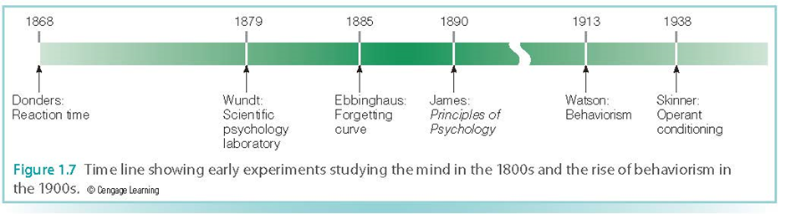
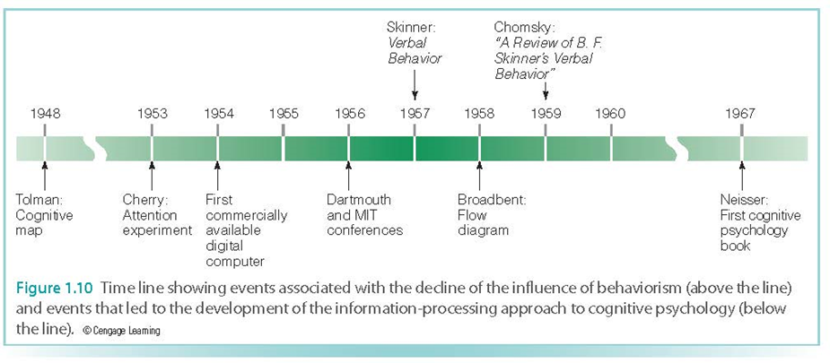
Notes:
Mental responses cannot be measured directly, but must be inferred from behavior
Donders: how long does it take to make a decision?
Wundt: Analytic introspection – trained subjects described their experiences and thought processes in response to stimuli (e.g., describe experience of hearing note on piano)
Ebbinghaus: Time course of forgetting; Savings – original time to learn the list – time to relearn the list after the delay; Memory can be measured!
William James: first cognitive psychology textbook! ← some of his thoughts still influential today!
Watson founded behaviorism: introspection is not a good method, observable behavior, not consciousness is the main topic of study.
Classical conditioning: pairing one stimulus with another, previously neutral stimulus causes changes in response to the neutral stimulus
Pavlov’s dogs: paired the food with a bell (initially neutral) caused the dog to salivate to bell
Skinner… Operant conditioning – how behavior is strengthened by the presentation of positive reinforcers, like food or social approval
Tolman (1948) – cognitive map: a conception within the rat’s mind of the maze’s layout (mental map); something other than S-R relationships are happening inside the rat’s mind ← still influential today!
Cognitive revolution: shift in psych from behaviorist stimulus-response relationship to an approach whose main thrust was to understand the operation of the mind
Cherry is dichotic listening task
Computers: information processing approach
Chomsky’s response to Skinner: children say many sentences that have never been rewarded by parents and that during the normal course of language development, they go through a stage in which they use incorrect grammar, which may not have been reinforced
And voila...

Slide 11
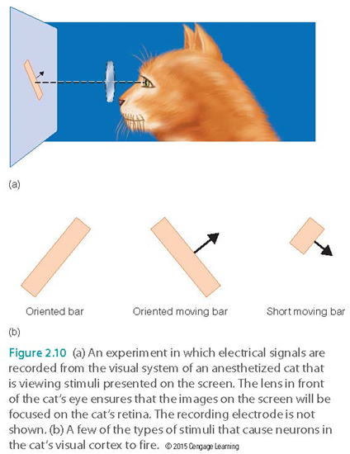
Feature Detectors: neurons that respond best to a specific stimulus

Slide 12
Hierarchical Processing
When we perceive different objects, we do so in a specific order that moves from lower to higher areas of the brain
The ascension from lower to higher areas of the brain corresponds to perceiving objects that move from lower (simple) to higher levels of complexity
Notes:
-this is why we end up calling it top-down vs. bottom-up processing

Slide 13
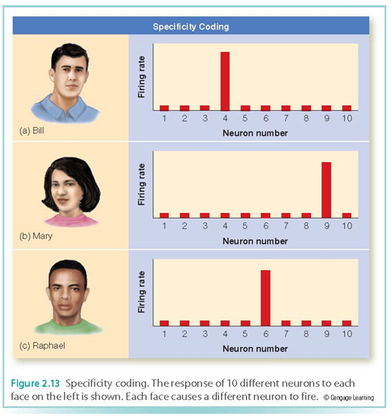
Specificity coding
representation of a specific stimulus by firing of specifically tuned neurons specialized to just respond to a specific stimulus
Notes:
•For faces, probably sparse coding
•BUT…
•Population coding and judgments of intentionality
•Single neurons code for predator escape in mollusks
•Different models apply for different situations

Slide 14
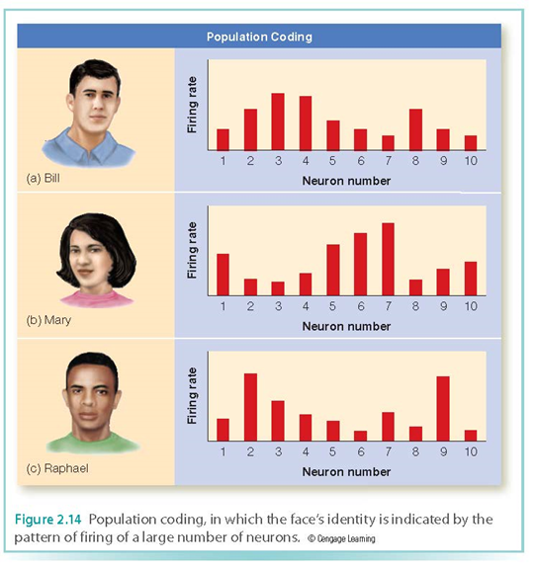
Population Coding
representation of a particular object by the pattern of firing of a large number of neurons
Notes:
•For faces, probably sparse coding
•BUT…
•Population coding and judgments of intentionality
•Single neurons code for predator escape in mollusks
•Different models apply for different situations

Slide 15
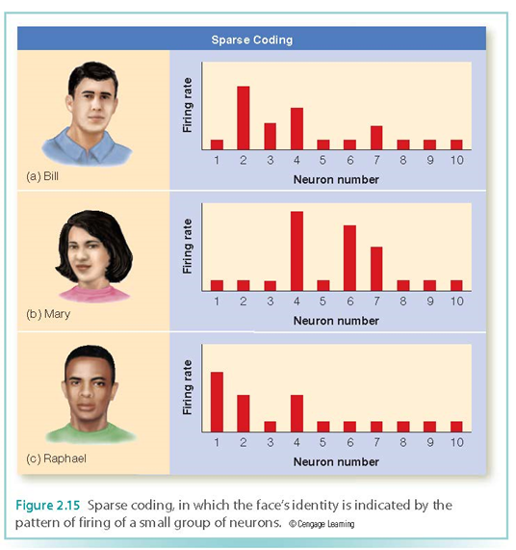
Sparse Coding
when a particular object is represented by a pattern of firing of only a small group of neurons, with the majority of neurons remaining silent
Notes:
•For faces, probably sparse coding
•BUT…
•Population coding and judgments of intentionality
•Single neurons code for predator escape in mollusks
•Different models apply for different situations

Slide 16
Localization of Function
Specific functions are served by specific areas of the brain
Breaks down when area damaged
Double Dissociations
Examples:
Language production: Broca’s area
Language comprehension: Wernicke’s area
Notes:
•Primary receiving areas for the senses
–Occipital lobe: vision
–Parietal lobe: touch, temperature, pain
–Temporal lobe: hearing, taste, smell
•Coordination of information received from all senses
–Frontal lobe

Slide 17
How is information processed?
Localized Representation
Fusiform Face Area: faces
prosopagnosia
Parahippocampal place area: places (indoor/outdoor scenes)
Extrastriate body area: pictures of bodies & parts of bodies
Distributed Representation
In addition to localization of function, specific functions are processed by many different areas of the brain
Many different areas may contribute to a function
May appear to contradict the notion of localization of function, but the two concepts are actually complementary
E.g., Kragel & Emotions
Notes:
•Localization of function
–Fusiform face area and faces
•Prosopagnosia patients
•Functional magnetic resonance imaging (fMRI)
•Single-unit recordings in monkeys
–Ventromedial prefrontal cortex and value
–Anterior cingulate and error detection
•Distributed representations
–Moral judgment and…
–How??

Slide 18
Takeaways
Our minds aren’t perfect computers – they’re made up of shortcuts that were good enough when it came to solving the problems of the environment we evolved in
These mechanisms can be fooled, which gives us clues as to how they work
Cognitive psychologists can’t observe cognitive mechanisms directly – have to infer them by looking at behavior and physiology
Organisms don’t have any direct access to reality – all we work with are neural representations
Certain cognitive functions are localized to certain regions of the brain. Nevertheless, many neural representations involve a distributed pattern of activity in multiple brain areas at once.

Slide 19
Optional: Test yourself
Which of the following can a neuron use to code for information?
The size of action potentials
The shape of action potentials
The duration of action potentials
The frequency of action potentials
What do cognitive psychologists talk about that behaviorists don’t?
What are the three different ways that neurons can represent a particular object? What are the two competing models for how neurons represent information at a higher level?
Test yourself sections in the textbook too for Chpts 1-2

Slide 20
Perception, Top-Down/Bottom-Up, Endogenous/Exogenous
Review material that we have covered so far

Slide 21
Perception Review

Slide 22
Perception Is Ambiguous
https://www.nytimes.com/interactive/2018/05/16/upshot/audio-clip-yanny-laurel-debate.html
Notes:
•Experience resulting from stimulation of the senses
•Basic concepts
–Perceptions can change based on added information
–Involves a process similar to reasoning or problem solving
–Perceptions occur in conjunction with actions

Slide 23
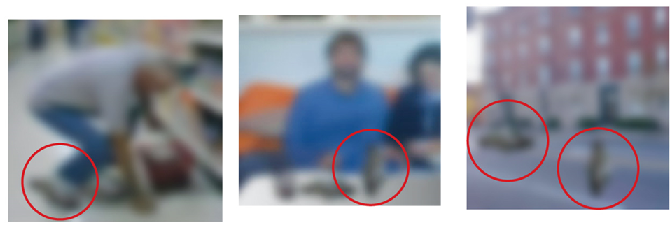
Perception Is Ambiguous

Slide 24
Challenges We, But Not Machines, Can Solve -- Why?
Objects can be hidden or blurred
People can often identify objects that are obscured and therefore incomplete, or in some cases objects that are blurry
Objects look different from different viewpoints
Viewpoint invariance
Inverse Projection Problem
Refers to the task of determining the object responsible for a particular image on the retina
Involves starting with the retinal image and then extending outward to the source of that image

Slide 25
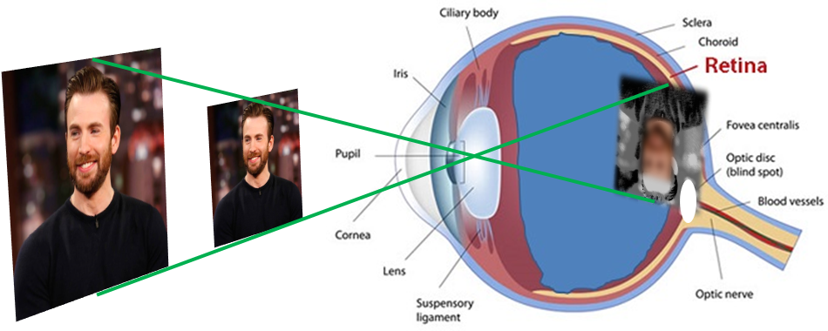
The Inverse Projection Problem
Notes:
Light from an object is inverted as it falls on the retina. The same pattern of light could be caused by an infinite number of different objects, yet our brains usually manage to make the correct interpretation. This is known as the inverse projection problem.
Slide image from Ellie Hanna

Slide 26
Top-down vs. Bottom-up
Bottom-up: usually refers to start of stimulus processing
Perception starts at the sensory input, the stimulus
Top-down: processing originating in the brain, possibly other signals modulating bottom-up
Perception could start with the brain
Usually higher order cognitive processes
Internal goals, prior knowledge, etc. influencing information processing
Pain, language, picture blobs (what do you see?), etc.
Flower looks beautiful vs. specifically looking for a flower
Notes:
§ Knowledge helps us characterize blurred ‘blobs’
§ Hearing words in a sentence: where one word ends and the next one begins (speech segmentation); people familiar with different languages can hear different stimuli in such segments
§ Experiencing pain: can be influenced by what a person expects, how the person directs his or her attention, and the type of distracting stimuli that are present; decrease in pain from a substance that has no pharmacological effect is the placebo effect (e.g., child looks to parents for how to respond to an accident; if they’re panicked, child – who has few expectations – becomes more panicked)

Slide 27
4 Perspectives on Perception
Helmholtz: retinal image ambiguous, so it solves ambiguity with the likelihood principle
We perceive the object most likely to have caused the pattern of stimuli we received
A Top-down approach on perception
Unconscious inference: our perceptions are also often the result of unconscious assumptions or inferences we make about the environment
I.e., Expectation and experience play a large role in perception, and sometimes we’re not even aware of that (“Learned Group”)
Notes:
•Some of our perceptions are the result of unconscious assumptions we make about the environment
–We use our knowledge to inform our perceptions
•We infer much of what we know about the world
•Likelihood principle: we perceive the world in the way that is “most likely” based on our past experiences

Slide 28

Notes:
https://www.youtube.com/watch?v=sKa0eaKsdA0
“This amazing illusion is so strong that even when we are aware that we are looking at the concave, reverse side of the mask we cannot stop ourselves perceiving it as a convex, protruding face!”

Slide 29

Notes:
https://www.youtube.com/watch?v=A4QcyW-qTUg

Slide 30
4 Perspectives on Perception
Statistical regularities in the environment
The oblique effect
Light-from-above
Semantic regularities
I.e., Expectation and experience play a large role in perception, and sometimes we’re not even aware of that (“Learned Group”)

Slide 31
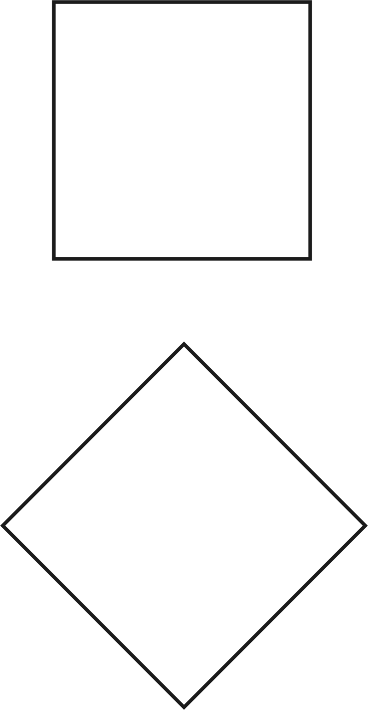
The Oblique Effect
People can perceive verticals and horizontals more easily than other orientations
Verticals and horizontals are more common in our world (“statistical regularity”)
Trees, buildings, etc.
(So neurons are also more tuned to verticals and horizontals too)
Notes:
§ People can perceive horizontals and verticals more easily than other orientations (“the oblique effect”)
https://en.wikipedia.org/wiki/Oblique_effect#/media/File:Machsquare.png

Slide 32
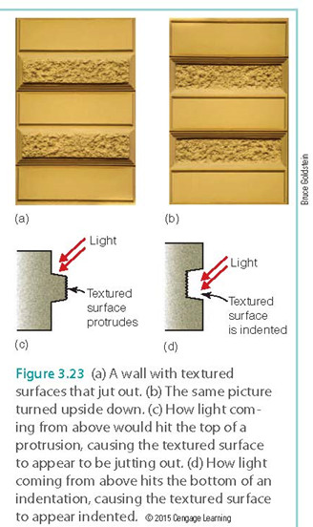
Light from Above
Light comes from above
Is usually the case in the environment
We perceive shadows as specific information about depth and distance
Notes:
§ Light-from-above assumption: usually assume light is coming from above, because the sun, most light, etc. do
Right is upside down of the left
Image credit: Cengage

Slide 33
Light from Above
Light comes from above
Is usually the case in the environment
We perceive shadows as specific information about depth and distance
Notes:
§ Light-from-above assumption: usually assume light is coming from above, because the sun, most light, etc. do
Image credit: Cengage

Slide 34
Semantic Regularities
Close your eyes and then visualize or simply think about the following scenes and objects:
An office
The clothing section of a dept store
A microscope
A lion
Notes:
What does each contain?
People likely to say office has a desk with a computer on it, bookshelves, a chair
Dept store has racks of clothes, changing room, etc.
§ What a given scene usually contains: a scene schema (visualizations contain information based on our knowledge of different kinds of scenes
•The meaning of a given scene is related to what is happening within that scene, and semantic regularities are the characteristics associated with the functions carried out in different types of scenes.
•A scene schema is the knowledge of what a given scene ordinarily contains (e.g., if you think of a professor’s office, what would you expect to find/see there?)

Slide 35
Semantic Regularities
Scene schemas: knowledge (from past experience) of what a given scene ordinarily contains
An office: a desk, chair, etc.
Notes:
What does each contain?
People likely to say office has a desk with a computer on it, bookshelves, a chair
Dept store has racks of clothes, changing room, etc.
§ What a given scene usually contains: a scene schema (visualizations contain information based on our knowledge of different kinds of scenes
•The meaning of a given scene is related to what is happening within that scene, and semantic regularities are the characteristics associated with the functions carried out in different types of scenes.
•A scene schema is the knowledge of what a given scene ordinarily contains (e.g., if you think of a professor’s office, what would you expect to find/see there?)

Slide 36
4 Perspectives on Perception
Bayesian Inference
Prior: our initial belief about about the probability of an outcome
Likelihood: the extent to which evidence is consistent w/ an outcome
Estimate of outcome influenced by these 2 factors. We update our expectations based on incoming evidence, and this process happens repeatedly.
I.e., Expectation and experience play a large role in perception, and sometimes we’re not even aware of that (“Learned Group”)
Notes:
•One’s estimate of the probability of a given outcome is influenced by two factors:
a.The prior probability (our initial belief about the probability of an outcome)
b.The likelihood of a given outcome
For example, if someone has a cough, many things can cause that (e.g., cold, TB, dry throat, etc. - prior). Interacting with that person, you see runny nose, watery eyes - it must be a cold (updating)!

Slide 37
4 Perspectives on Perception
Gestalt psychologists: the mind groups patterns according to laws of perceptual organization:
Good continuation
Simplicity/Good Figure/Pragnanz
Similarity
I.e., a person’s experience can influence perception, but experience plays a smaller role than perceptual principles (i.e., perception is intrinsic & has laws; “Innate Group”)
Notes:
•“Old” view – structuralism
–Perception involves adding up sensations
•“New” view – Gestalt psychologists
–The mind groups patterns according to laws of perceptual organization
•Gestalt laws often provide accurate information about properties of the environment
–Reflect experience
–Experience is important but does not overcome perceptual principles
•Gestalt laws are intrinsic

Slide 38
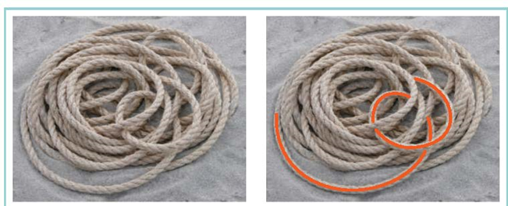
Good Continuation
Lines tend to be seen as following the smoothest path
Notes:
o Good continuation: points that when connected result in straight or smoothly curving lines are seen as belonging together, following the smoothest path. Objects that are overlapped by others are perceived as continuing behind the overlapping object
Image credit: cengage

Slide 39

Simplicity: Five Circles, Not 9 Shapes
Every stimulus pattern is seen so the resulting structure is as simple as possible
Notes:
o Pragnanz (Good Figure or Simplicity): every stimulus pattern is seen in such a way that the resulting structure is as simple as possible

Slide 40

Similarity:
Similar things appear grouped together
“Waves” - Wilma Hurskainen
Notes:
o Similarity: similar things are grouped together

Slide 41
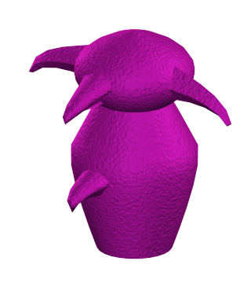
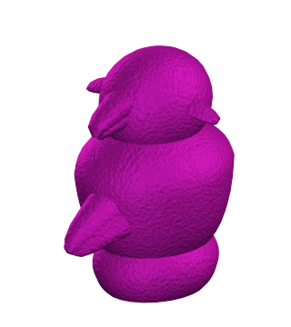
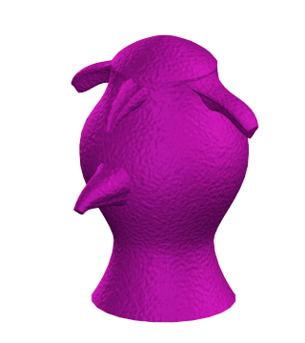
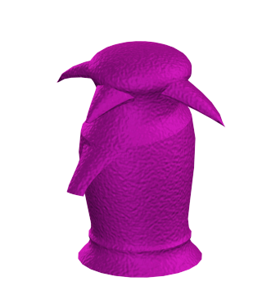
Experience-Dependent Plasticity
The structure of the brain is changed by experience: the case of Greebles (Isabel Gauthier)
Notes:
https://en.wikipedia.org/wiki/Greeble_(psychology)
•Neurons become tuned to respond best to what we commonly experience
–Horizontals and verticals
–Experience-dependent plasticity

Slide 42
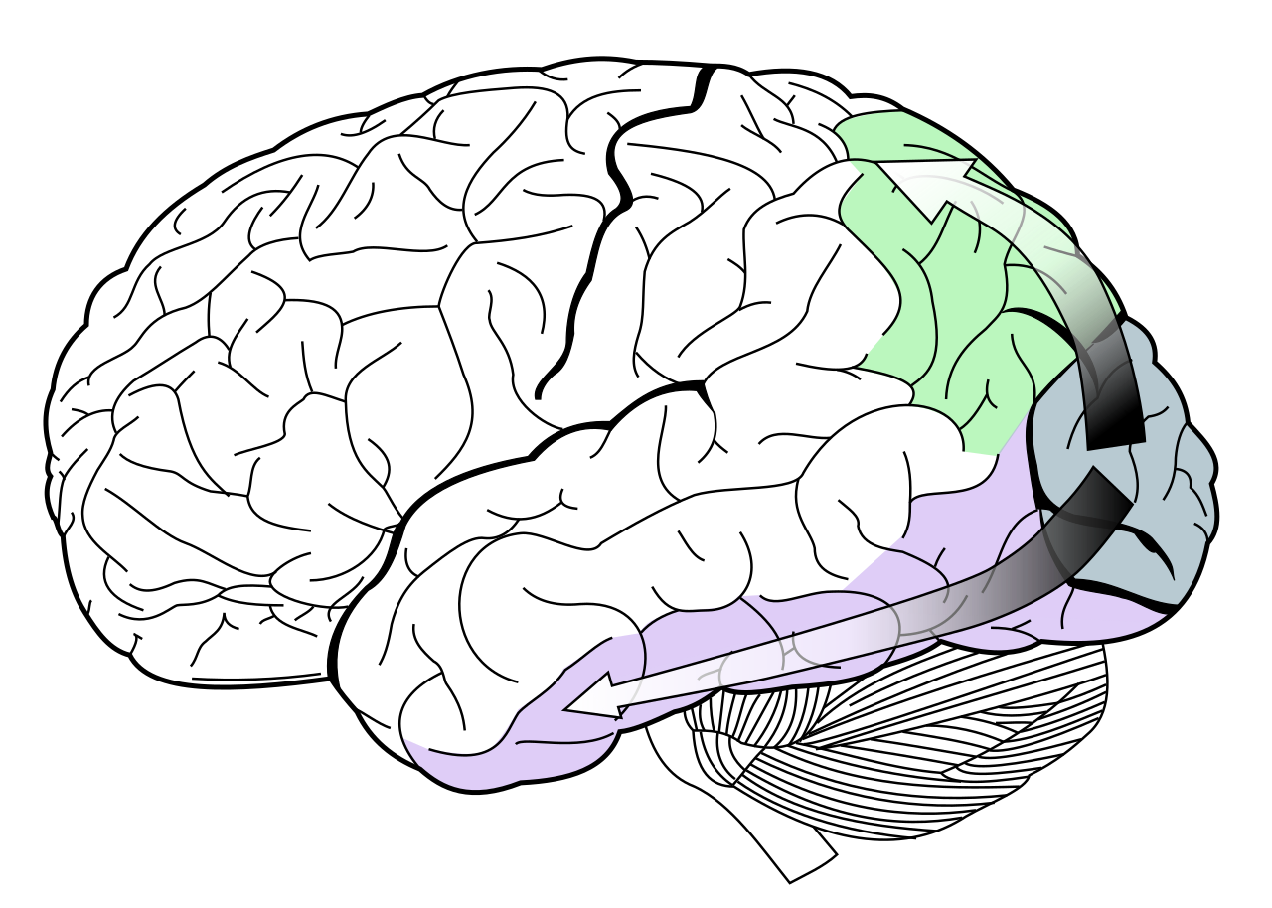
Processing Streams
•What stream: identifying an object
•Where stream: identifying the object’s location
Where / Action pathway
What / Perception pathway
Notes:
https://en.wikipedia.org/wiki/Two-streams_hypothesis#/media/File:Ventral-dorsal_streams.svg
o Determined these pathways via brain ablations + neuropsychology studies
· Pathway from striate cortex to temporal lobe: what pathway
· Pathway from striate cortex to parietal lobe: where pathway
o One mechanism for judging orientation, another for coordinating vision and action
· Pathway from visual cortex to temporal lobe: perception pathway
· Pathway from visual cortex to parietal lobe: action pathway

Slide 43
Takeaways
Our perceptions come about as a result of both top-down and bottom-up processing
We automatically make inferences about raw sensory information to make meaning out of it
Most psychologists emphasize the role of experience in the perceptual inferences we make. However, the Gestalt psychologists believed that perceptual inferences are intrinsic to the system (we don’t need to learn them)
The Gestalt psychologists came up with a list of principles that they believed perception adheres to

Slide 44
Top-down/endogenous vs. Bottom-up/exogenous Review

Slide 45
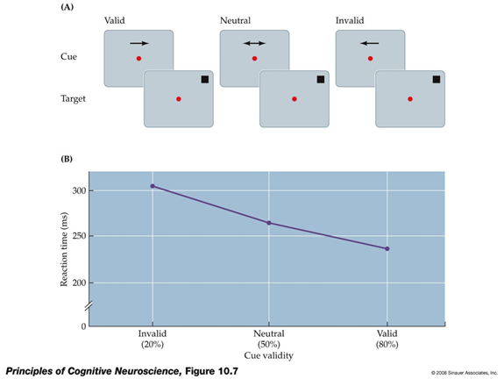
Endogenous Cueing (Posner)
Notes:
Attention can be guided endogenously (‘top-down’, i.e. by our internal goals) or exogenously (‘bottom-up’, i.e. by salient stimulus features of the environment). Fig.: a typical endogenous cuing study (‘Posner task’), where target detection times are fastest following valid cues, and slowest following invalid cues.

Slide 46
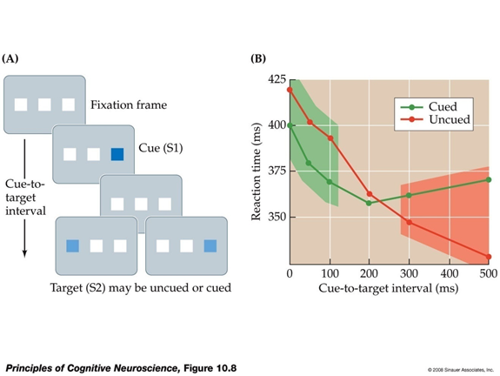
Exogenous Cueing
Notes:
Fig.: a typical exogenous cuing study, where salient but task-irrelevant stimuli attract attention (‘attentional capture’). Note that the capture effect starts early, is short-lived, and reverses if the salient distractor stimulus precedes the target by more than circa 300ms (‘inhibition of return’).

Slide 47
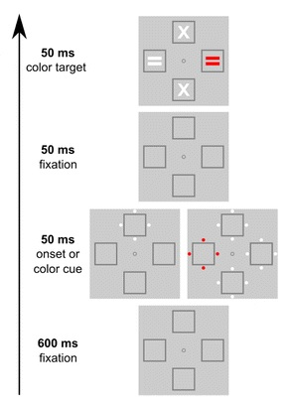
Contingent Capture:
Top-down & bottom-up can interact
Search for red equals sign (top-down goal);
Only the red circles outside the box will capture attn (bottom-up) b/c of your top-down goal (where is the red =)?
Trial starts here
Folk et al., 1992, JEP:HPP
Notes:
Importantly, top-down and bottom-up influences on attention interact, as evident in the finding of “contingent capture”: When asked to detect the location of a color “singleton” stimulus (here, the red “=“ symbol), subjects’ spatial attention will be captured “bottom-up” by a preceding cue only if it is a color cue (i.e., relevant to the current task set), but not if it is a sudden-onset cue (not relevant to task, but usually a potent stimulus to capture attention).

Slide 48
Other Review

Slide 49
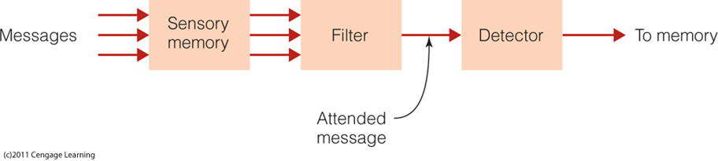
Early Selection: Broadbent’s Filter Model of Attention (1958):
Filters message before incoming information is analyzed for meaning
Notes:
o If you don’t attend to it, it’s lost
•Sensory memory
–Holds all incoming information for a fraction of a second
–Transfers all information to next stage
•Filter
–Identifies attended message based on physical characteristics
–Only attended message is passed on to the next stage
•Detector
–Processes all information to determine higher-level characteristics of the message
•Short-term memory
–Receives output of detector
–Holds information for 10-15 seconds and may transfer it to long-term memory

Slide 50
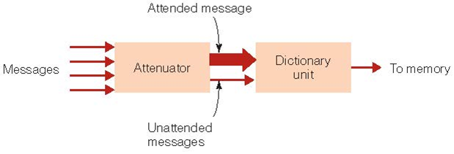
“Intermediate” Selection: Treisman’s attenuation model of attention (1964):
Attended message can be separated from unattended message early in the information-processing system; selection can still occur later
Notes:
Image credit: Cengage
o A “leaky filter” model
•Attenuator
–Analyzes incoming message in terms of physical characteristics, language, and meaning
•Attended to message is let through the attenuator at full strength
•Unattended message is let through at a much weaker strength
•Dictionary unit
–Contains words, each of which have thresholds (i.e., smallest signal strength that can be detected)
for being activated
•Words that are common or important have low thresholds
•Uncommon words have high thresholds

Slide 51
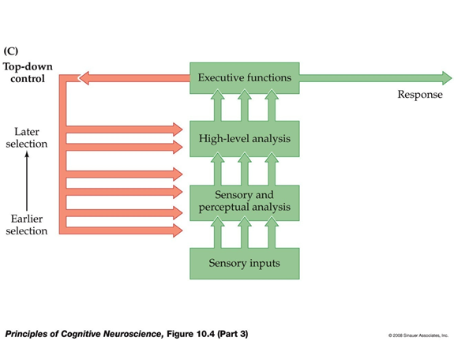
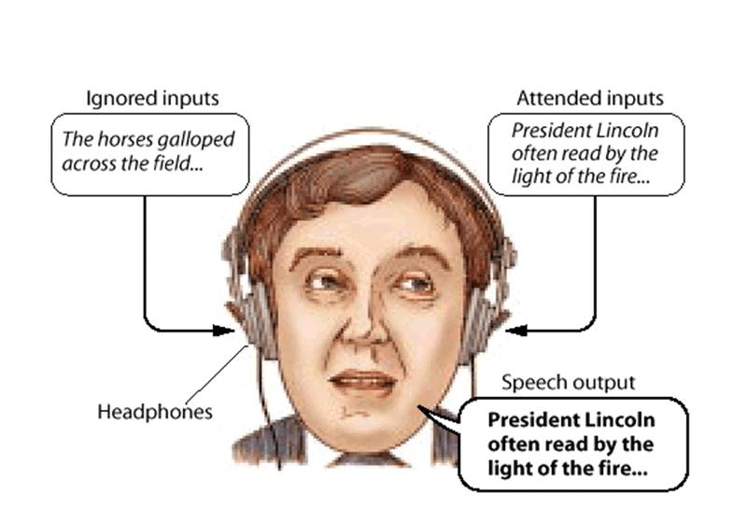
Late Selection Models
Most information processed to level of meaning before message is selected
People used dichotic listening tasks to differentiate the models, but no one answer to early vs. late debate
Notes:
· Dichotic listening task:
- Participant’s name gets through (early selection/Broadbent can’t explain)
- Participants can shadow meaningful messages that switch from one ear to another (early selection/Broadbent can’t explain)
- In attending ear, hear ambiguous sentences; combined the word they heard in unattended stream w/ ambiguous sentence in later report. I.e., meaning can get through. (early selection can’t explain)
· Late selection models of attention: most of the incoming information is processed to the level of meaning before the message to be further processed is selected
No one answer to the early-late controversy; early selection demonstrated in some circumstances, late in others. Focus shifted to the factors that control attention.
Image credit: https://www.simplypsychology.org/attention-models.html

Slide 52
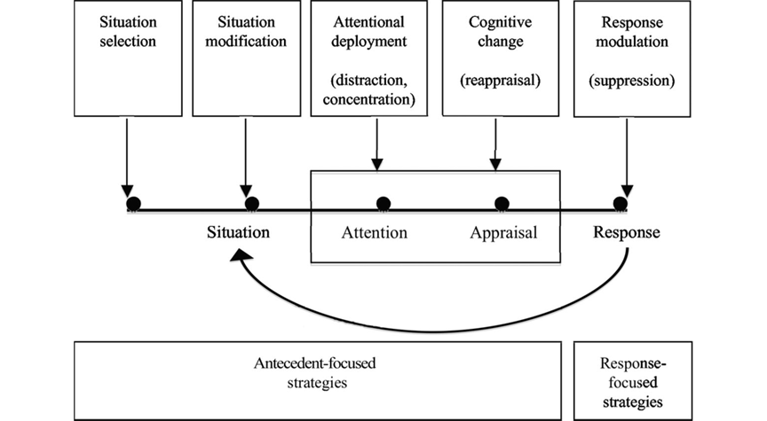
Gross’s model of emotion regulation
Notes:
Situation selection: You can choose to put yourself into a potentially awkward situation or spend your time doing something else. (Avoiding or approaching)
While you are in a particular situation, you can also modify what happens during it. (e.g., temporal distance - put space between you and the person…)
You can also choose which particular aspects of the situation to focus on or selectively deploy your attention. (e.g., I’m not going to focus on the bad thing that happened; distraction, rumination, worry, thought suppression).
The meaning that you ascribe to the event can also be modulated through changing cognition… How you choose to think about these situations especially how you can reframe or reappraise your thinking in a more positive or adaptive light is the focus of many types of behavioral therapy.
After the emotional response occurs, you may choose to suppress your emotions, or use drugs or alcohol to alter both your cognitive experience as well as your body’s physiological responses. Many of these response modulations involve avoidance strategies...
Gross (1998b) specifically examined the difference between antecedent- and response-focused regulation strategies and found that although both methods were effective at reducing emotion expression, antecedent strategies (reappraisal) were better at reducing the experience of emotion while response strategies (suppression) induced physiological changes. This suggests that antecedent- and response-focused emotion regulation processed may have different purposes and mechanisms.

Slide 53
Today’s Goals + Agenda
LO1: Continue to build a supportive classroom culture & discuss science communication.
Peer feedback of opening SciComm paragraphs in groups
Discuss choosing Wikipedia scientists for assignment
LO2: Describe the basic history of cognitive psychology & cognitive psychology perspectives on cognitive neuroscience
Review material from discussing Day 2 methodology, plus some basic principles on cog neuro
LO3: Review material that we have covered so far
Class feedback: wanted to slow down a bit & review Perception, some Attention concepts

Slide 54
Tuesday’s Work
Second Quiz
Attention, Emotion, Sensory Coding, SciComm
Choose 4 Cog Psychologists for Wikipedia
Readings:
Bergelson & Aislin (2017) (Duke)
Yu et al. (2019)
Science News papers: Gutman (2017) (covering Bergelson paper) & Hayakawa and Marian (2019) (summary of language research in SciAm)

Slide 55
Participation
https://tinyurl.com/PSY102Participation

Slide 56
Practice Questions
Optional: Test yourself on material

Slide 57
When Sam listens to his girlfriend Susan in the restaurant and ignores other people’s conversations, he’s engaged in the process of ___ attention.
Low load
Divided
Cocktail party
Selective

Slide 58
The cocktail party effect is
The ability to pay attention to one stimulus while filtering out other stimuli
The inability to pay attention to one stimulus in the presence of competing stimuli
The diminished awareness of information in a crowd
The equal division of attention between competing stimuli
Follow-up: how does the cocktail party effect illustrate key characteristics of attention?

Slide 59
Broadbent’s model is called an early selection model because:
The filter eliminates unattended information right at the beginning of the flow of information
The filtering step occurs before the information enters the sensory store
Only a select set of environmental information enters the system
Incoming information is selected by the detector

Slide 60
Which of the following results would cause a problem for Broadbent’s early selection model:
A result where listeners don’t notice words presented up to 35 times in the unattended ear
A result where listeners can shadow a message presented in the attended ear
A result where listeners can hear their own name in the unattended ear
A result where listeners can shadow meaningful messages that switch from one ear to another
2 answers here

Slide 61
Suppose twin teenagers are vying for their mother’s attention. The mother is trying to pay attention to one of her daughters, though both girls are talking (one about her boyfriend, one about a school project). According to the operating characteristics of Treisman’s attenuator, it is most likely the attenuator is analyzing the incoming messages in terms of:
Physical characteristics
Language
Meaning
Direction

Slide 62
According to Treisman’s “attenuation model,” which of the following would you expect to have the highest threshold for most people?
The word ‘money’
Their child’s first name
The word ‘home’
The word ‘platypus’

Slide 63
Suppose you are in your kitchen writing a grocery list, while your roommate is watching TV in the next room. A commercial for spaghetti sauce comes on TV. Although you are not paying attention to the TV, you ‘suddenly’ remember that you need to pick up spaghetti sauce and add it to the list. Your behavior is best predicted by which of the following models of attention?
Object-based
Early selection
Spotlight
Late selection

Slide 64
The Stroop effect occurs when participants
Are told to divide their attention between colors and color-words
Try to name colors and ignore the meaning of color-words
Try to select some incoming information based on meaning.
Are told to shadow two messages simultaneously

Slide 65
What’s the difference between change blindness and inattentional blindness? Discuss 2 ways of demonstrating change blindness.
Discuss how the process of binding is essential in your ability to watch a movie or television program.
How does automaticity relate to multitasking?
For Emotion, think about basics: how is an emotion generated? What do different theories tell us about how emotion is felt in the moment? What was the purpose of the papers you read? What is an emotion? How do we regulate our emotions?

Slide 66
MC answer key
Slide 57: selective
Slide 58: ability to pay attn
Slide 59: filter eliminates
Slide 60: bottom 2 arrow points
Slide 61: meaning
Slide 62: platypus
Slide 63: late selection
Slide 64: try to name colors

Slide 67
Test your perception knowledge

Slide 68
Computer programs have been designed that can recognize matching human faces with the same accuracy as a human being, but the computer loses its efficiency at this process when
Animals faces are substituted for human faces
The faces are of children
The faces are viewed from an angle
The faces are of people with scars or deformities

Slide 69
During a professional baseball game, a long fly ball is hit down the first base line toward the foul ball pole. If it goes to the right of the pole, it will be a foul ball, and if it goes to the left, it will be a home run. The umpire making this call will have the most difficulty making the judgment because:
The umpire will be looking right at the foul pole instead of viewing it from an angle
The human visual perceptual system is simply inefficient at making judgments in cases where the visual stimuli are more than a few feet away.
It can be very difficult to distinguish one item from another when there is overlap between the two
The ball will probably disappear from view whether it goes in front of or behind the foul pole

Slide 70
If a word is identified more easily when it is in a sentence than when it is presented alone, this would be an example of ____ processing.
Top-down
Bottom-up
Serial
Sequential

Slide 71
Maria took a drink from a container marked ‘milk.’ Surprised, she quickly spit out the liquid because it turned out the container was filled with orange juice instead. Maria likes orange juice, so why did she have such a negative reaction to it. Her response was most affected by:
Reception of the stimulus
Bottom-up processing
Top-down processing
Focused attention

Slide 72
The results of Gauthier’s “Greeble” experiment illustrate:
That neurons specialized to respond to faces are present in our brains when we are born
That training a monkey to recognize the difference between common objects can influence how the monkey’s neurons fire to these objects
An effect of experience-dependent plasticity
That our nervous systems remain fairly stable in different environments

Slide 73
MC Answer Key
Slide 68: viewed angle
Slide 69: overlap
Slide 70: top-down
Slide 71: top-down
Slide 72: experience dependent plasticity

